Slide 1
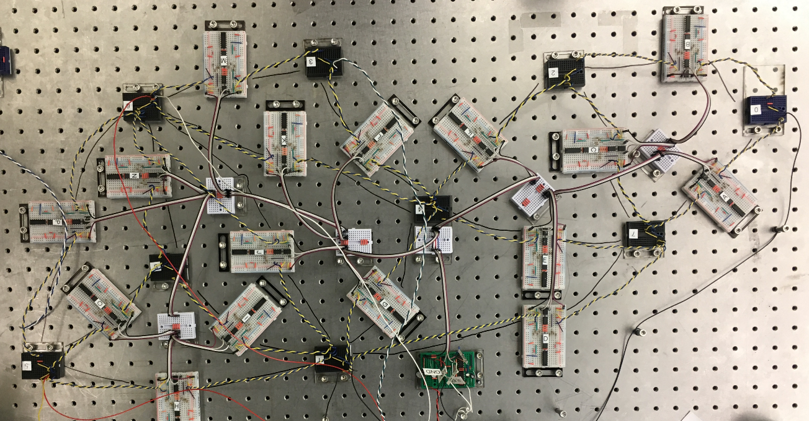
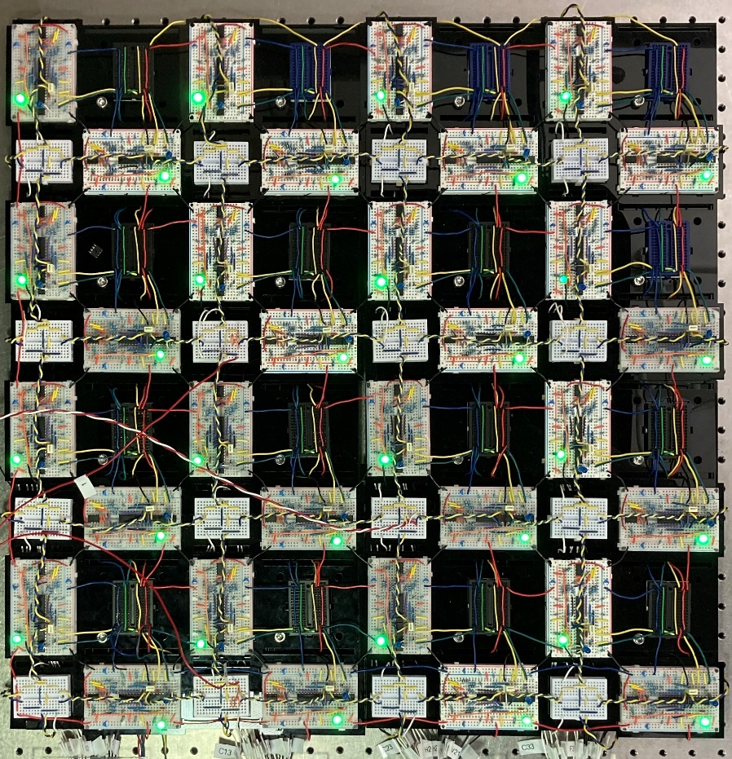
How Physical Systems Can Learn By Themselves:
What AI Can Do For Physics and what Physics can do for AI
Andrea J. Liu
University of Pennsylvania
Menachem Stern UPenn
Sam Dillavou UPenn
Jacob Wycoff UPenn
Jason Rocks UPenn/BU
Carl Goodrich UPenn/IST Austria
Daniel Hexner UChicago/Technion
Nidhi Pashine UChicago/MIT
Henrik Ronellenfitsch UPenn/Williams
Marc Miskin UPenn
Doug Durian UPenn
Eleni Katifori UPenn
Sid Nagel UChicago

Slide 2
Your Brain Vasculature Is Amazing
Brain is 2% of body mass but uses ~20% of O2
Brain vasculature provides desired outputs given inputs
Input signal: blood enters brain via arteries (input blood current)
Output signal: enhanced blood/O2 pressure drop at specific local region (output blood current)
vessels contract/dilate to achieve desired output current
Vasculature delivers localized enhanced blood current to different locations on demand (fMRI)
http://campar.in.tum.de/Main/ProjectVascularNetworks
Can we design systems (at least on computer) that can do this?

Slide 3
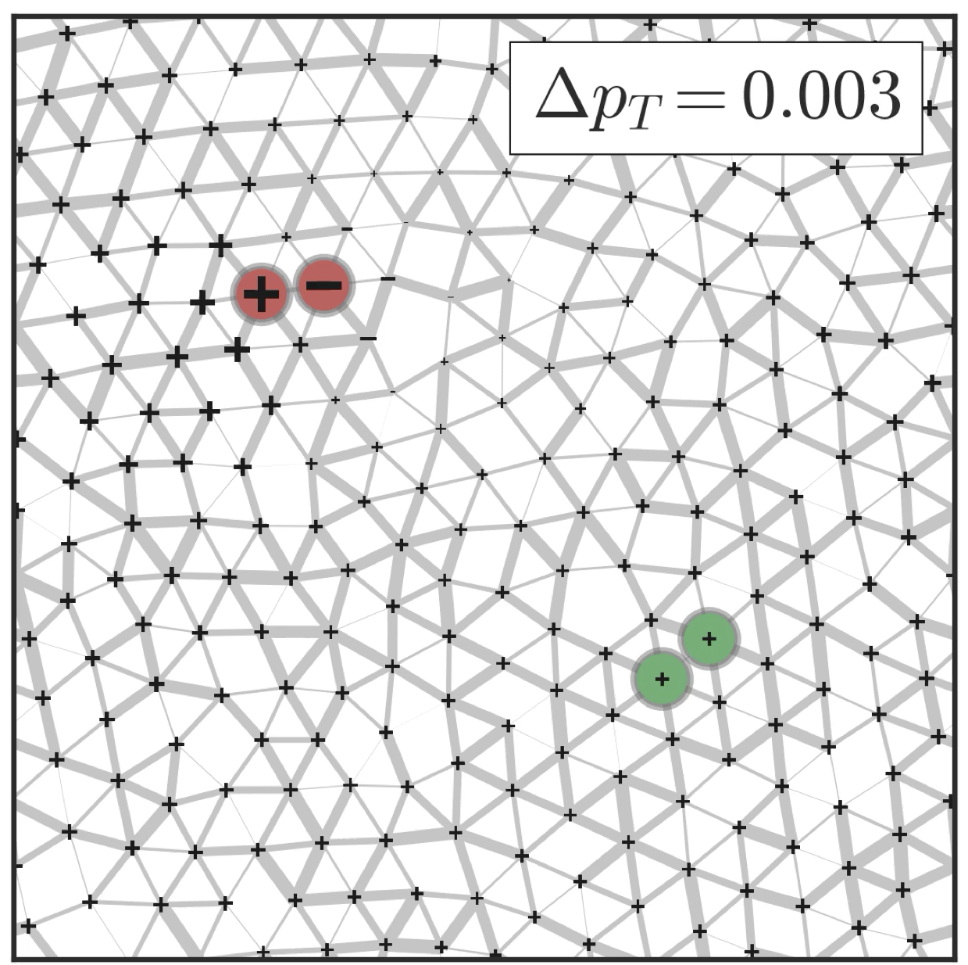
From Biological System to Physics Model
Network of pipes or edges (blood arteries/vessels/capillaries) that connect junctions or nodes
Brain vasculature has ~million edges
Input
Output
How to adjust resistance of each pipe to get desired output?
brain vasculature
flow network

Slide 4
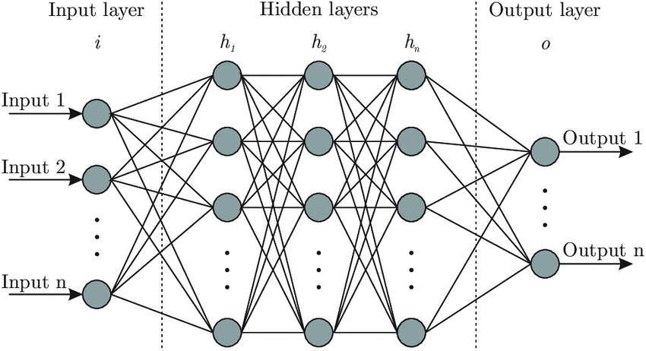
Neural Networks Can Be Trained for Desired Input/Output Relations
First step: apply inputs and calculate outputs
Learning cost function
Learning degrees of freedom: model parameters (node weights)
Second step: ski downhill (gradient descent) on with respect to learning DOF
Repeat until
Output 1 (1 for dog, 0 for cat)
Output 2 (1 for cat, 0 for dog)

Slide 5
Skiing (Gradient Descent) in High Dimensions
Skiing: move downhill in altitude landscape by adjusting 2 position degrees of freedom (latitude and longitude)
Google Translate has ~100 million parameters; ChatGPT4 ~1 trillion
Training Google Translate required skiing downhill in the learning cost function landscape by adjusting ~100 million learning degrees of freedom!

Slide 6
Neural Networks Can Be Trained for Desired Input/Output Relations
First step: apply inputs and calculate outputs
Learning cost function
Learning degrees of freedom: model parameters node weights
Second step: ski downhill on with respect to learning DOF
Repeat in flow networks! But neural networks are not real
Real systems have to obey physics
Output 1 (1 for dog, 0 for cat)
Output 2 (1 for cat, 0 for dog)

Slide 7
Physics Imposes An Extra Complication
car current
on
highway network
fluid current
in
flow network
electrical current
in
resistor circuit
Physics requires that current entering each node = current exiting each node
What goes in must come out: conservation law called Kirchhoff’s law
Minimizing power dissipated in entire network enforces Kirchhoff’s law

Slide 8
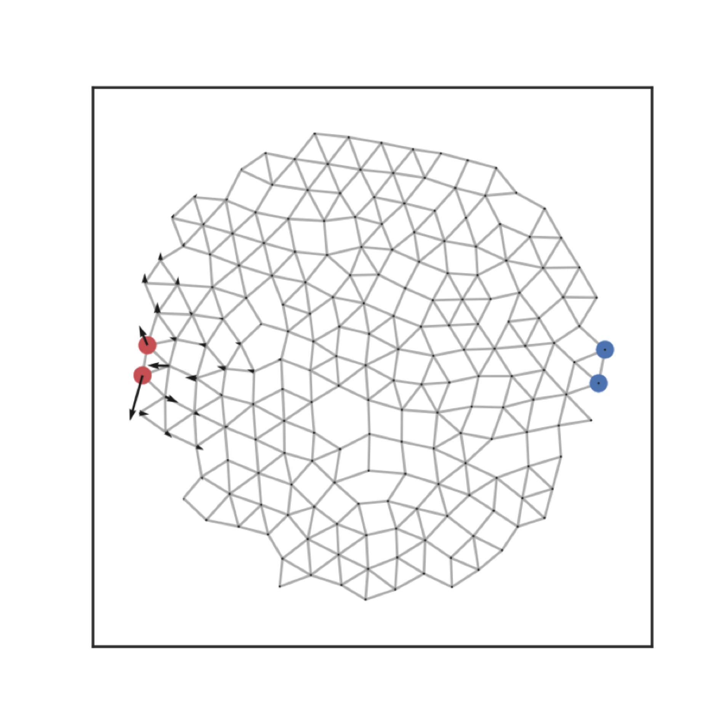
Double Gradient Descent for Desired Input/Output Relations
Learning cost function:
Learning degrees of freedom: pipe resistances/edge resistances
Physical cost function: dissipated power
Physical DOF: junction pressures/voltages
1st descent: Minimize physical cost function wrt physical DOF—required by physics!
2nd descent: Use gradient descent to minimize learning cost function wrt learning DOF
Skiing in 2 coupled high-D landscapes at once!
target
source
Rocks, Pashine, Goodrich, Bischofberger, Liu, Nagel PNAS 2017

Slide 9
Double Gradient Descent: It Works!
Learning cost function:
Learning degrees of freedom: pipe resistances/edge resistances
Physical cost function: dissipated power
Physical DOF: junction pressures/voltages
1st descent: Minimize physical cost function wrt physical DOF—required by physics!
2nd descent: Use gradient descent to minimize learning cost function wrt learning DOF
Rocks, Ronellenfitsch, Liu, Nagel, Katifori PNAS 2019

Slide 10
Double Gradient Descent Is Great! BUT…
Learning cost function:
Learning degrees of freedom: pipe resistances/edge resistances
Physical cost function: dissipated power
Physical DOF: junction pressures/voltages
1st descent: Minimize physical cost function wrt physical DOF—required by physics!
2nd descent: Use gradient descent to minimize learning cost function wrt learning DOF
target
source
global: require processor
Rocks, Pashine, Goodrich, Bischofberger, Liu, Nagel PNAS 2017

Slide 11
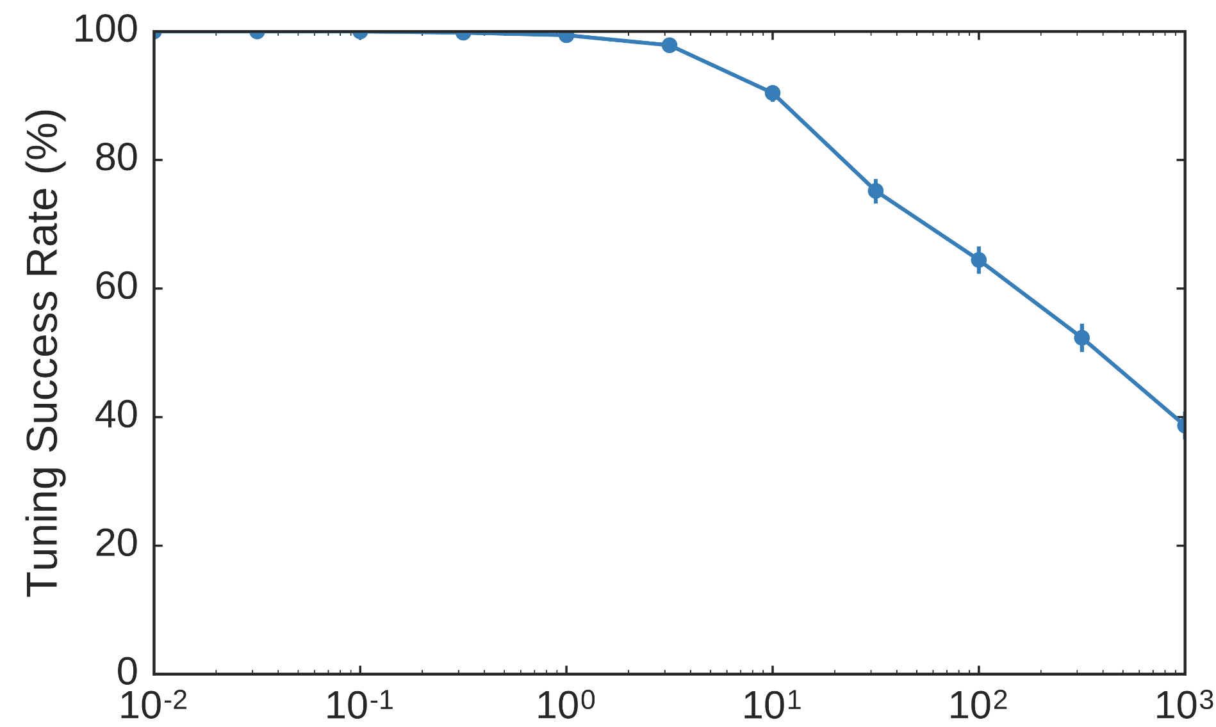
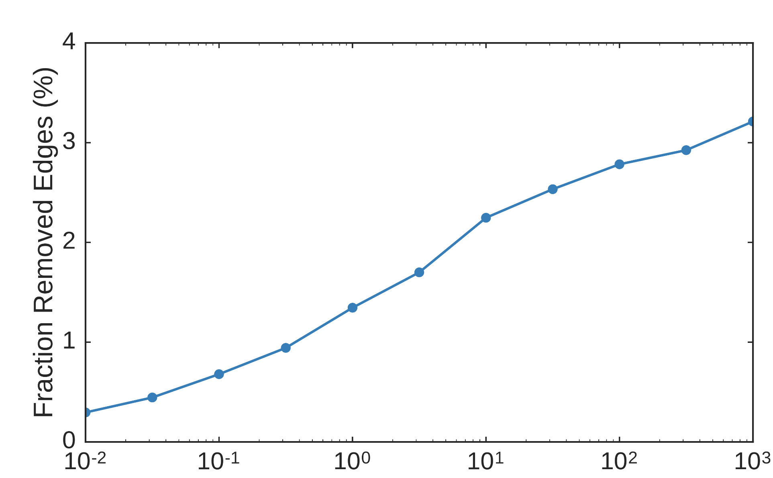
Double Gradient Descent is Successful and Efficient
Can tune to Δ=1
with essentially 100% success
by pruning tiny fraction of bonds
tuned target response Δ
tuned target response Δ
Rocks, Pashine, Goodrich, Bischofberger, Liu, Nagel PNAS 2017

Slide 12
2D Lasercut Realizations In Real Life
Double gradient descent on computer yields
designs that are robust in the lab
Rocks, Pashine, Goodrich, Bischofberger, Liu, Nagel PNAS 2017

Slide 13
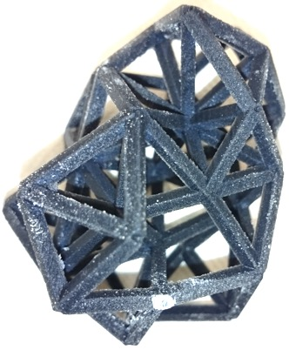
3D-Printed Realizations In Real Life
Double gradient descent on computer yields
designs that are robust in the lab
Rocks, Pashine, Goodrich, Bischofberger, Liu, Nagel PNAS 2017

Slide 14
Drawbacks of Global Process of Double Gradient Descent
Not scalable
Requires precise microscopic knowledge of network geometry and all the pipe resistances to evaluate learning and physical cost functions
Requires processor to calculate direction of gradient descent (which way is downhill?)
requires ability to modify individual pipe resistances of network
Design by minimizing cost function is inherently global and requires processor
This is a problem for neural networks, too—growth is unsustainable
Energy required to train neural networks is doubling every 3.4 months
Energy required to run trained networks is likewise increasing (~Argentina/Netherlands by 2027)
Whole rivers are used to cool data centers that run trained neural networks
In 2022, data centers used 1-1.5% of the world’s electricity

Slide 15
Drawbacks of Global Process of Double Gradient Descent
Not scalable
Requires precise microscopic knowledge of network geometry and all the pipe resistances to evaluate learning and physical cost functions
Requires processor to calculate direction of gradient descent (which way is downhill?)
requires ability to modify individual pipe resistances of network
Design by minimizing cost function is inherently global and therefore requires processor
This is a problem for neural networks, too
Can systems learn input/output relations on their own, without a processor?
The brain can

Slide 16
Artificial vs. Real Neural Networks
Take one step closer to brain by updating learning DOF with local rules
Output 1 (1 for dog, 0 for cat)
Output 2 (1 for cat, 0 for dog)
Lives on processor
Learning concentrated in processor
Fragile to damage to processor
Each ChatGPT text query ~ 200 kJ
Image generation ~10,000 kJ
Doesn’t need processor
Learning is distributed
Robust to damage
Adult human brain uses ~ 2000 kJ/day
Brain controls thought, memory, senses, motor skills, every process that regulates our bodies

Slide 17
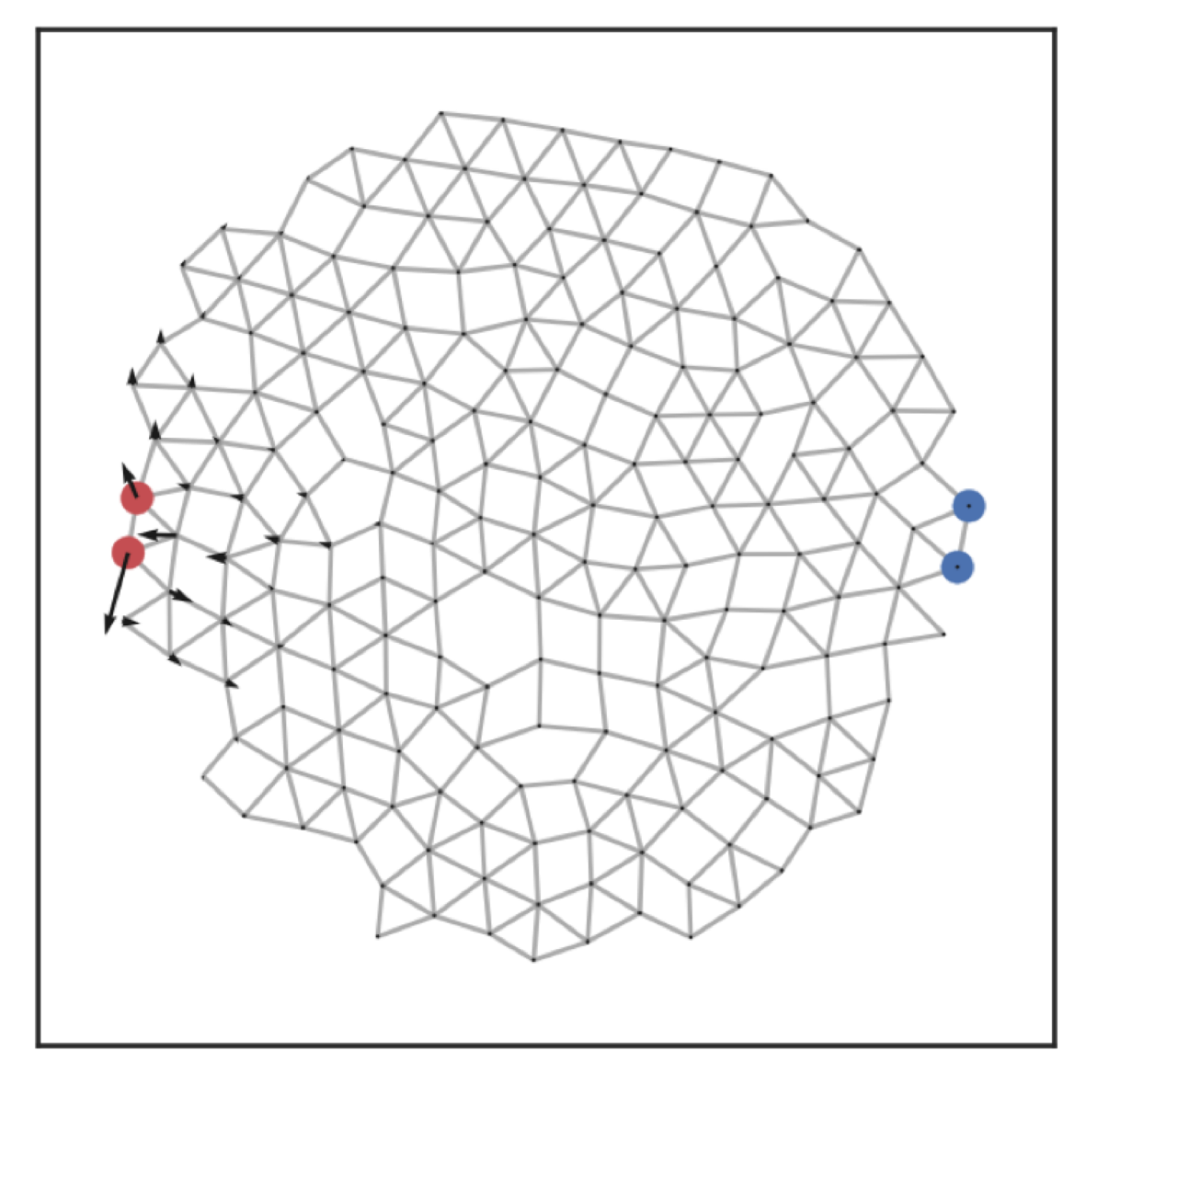
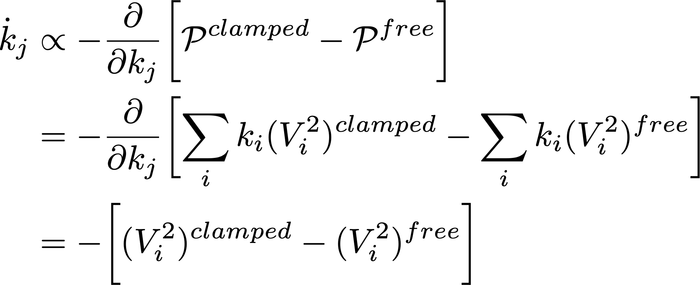
Coupled Learning: Let Physics Do the Work
Free
Clamped
Exploit contrastive learning
Scellier/Bengio Comp Neuro 2017
Kendall et al arXiv 2020
apply
source
leave target free
apply
source
apply desired target
response
*
Cost function = (desired response -free response)²
Contrast function = P^{clamped} -P^{free} ≥ 0 thanks to physics!
nudging
Purely local rule
leads to gradient descent on contrast function!
Stern, Hexner, Rocks, Liu PRX 2021

Slide 18
Coupled Learning Can Do Allostery
Flow networks
Mechanical networks
error
N=512
N=1024
N=512
N=1024
k-model
ℓ-model
Stern, Hexner, Rocks, Liu PRX 2021

Slide 19
Coupled Learning Can Do Classification!
Classification of handwritten digits
Input nodes: top 25 principal components of images
Output node 1: larger value means 0
Output node 2: larger value means 1
edge width = conductivity
edge width = power
Stern, Hexner, Rocks, Liu PRX 2021

Slide 20
But Coupled Learning on the Computer Is Still Not Scalable
Learning cost function:
Learning degrees of freedom: pipe resistances/edge resistances
Physical cost function: dissipated power
Physical DOF: junction pressures/voltages
1st descent: Minimize physical cost function wrt physical DOF—required by physics!
2nd descent: Use gradient descent to minimize learning cost function wrt learning DOF
target
source
Global
Require processor
Rocks, Pashine, Goodrich, Bischofberger, Liu, Nagel PNAS 2017

Slide 21
But Coupled Learning on the Computer Is Still Not Scalable
Learning cost function:
Learning degrees of freedom: pipe resistances/edge resistances
Physical cost function: dissipated power
Physical DOF: junction pressures/voltages
1st descent: Minimize physical cost function wrt physical DOF—required by physics!
2nd descent: Use gradient descent to minimize learning cost function wrt learning DOF
target
source
In real system physics AUTOMATICALLY minimizes the physical cost function—forward calculation is free!

Slide 22
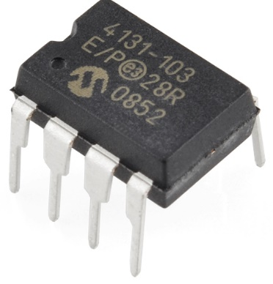
First Generation Processor-Free Physical Learning Networks
Digital variable resistors are readily available
But how to compare local power of resistor i in free and clamped states and update R_{i} by coupled learning rule without memory or processor?
$$R=δR × \left\{1, 2, 3,…, or 128\right\}$$

Slide 23
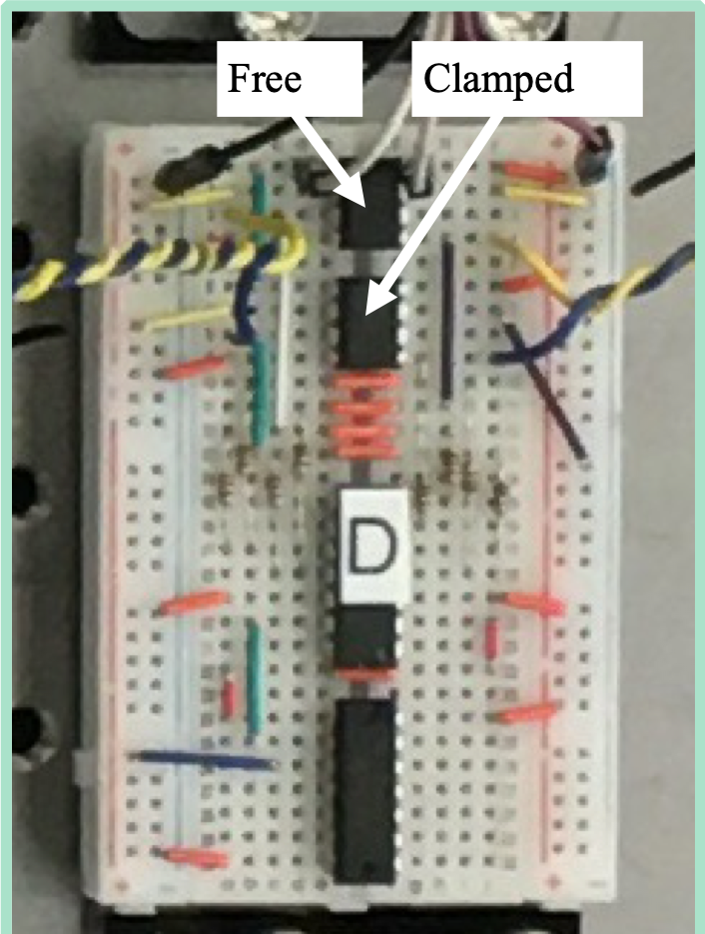
First Generation Processor-Free Physical Learning Networks
Digital variable resistors are readily available
But how to compare local power of resistor i in free and clamped states and update R_{i} by coupled learning rule without memory or processor?
Solution: Build identical twin networks:
One runs free BCs, the other runs clamped BCs
Corresponding resistors are on same breadboard
Circuitry implements a modified coupled learning rule:
$$R=δR × \left\{1, 2, 3,…, or 128\right\}$$
one twin edge:
Dillavou, Stern, Liu, Durian PRApplied (2022)

Slide 24
First Generation Processor-Free Physical Learning Networks
Digital variable resistors are readily available
But how to compare local power of resistor i in free and clamped states and update R_{i} by coupled learning rule without memory or processor?
Solution: Build identical twin networks:
One runs free BCs, the other runs clamped BCs
Corresponding resistors are on same breadboard
Circuitry implements a modified coupled learning rule:
$$R=δR × \left\{1, 2, 3,…, or 128\right\}$$
1st-generation prototype
9 junctions/16 self-adjusting resistors
Dillavou, Stern, Liu, Durian PRApplied (2022)

Slide 25
Classifying Irises
4 source junctions for measurements of 4 quantities
3 target junctions for 3 types of irises
Classification accuracy = 97%! It really works!
Dillavou, Stern, Liu, Durian PRApplied (2022)

Slide 26
Teaching an Old Network New Tricks
Dillavou, Stern, Liu, Durian PRApplied (2022)

Slide 27
This Is Great! BUT…
Because the network is made of resistors, it is linear and it can only learn limited range of tasks
Nonlinearity is essential for wider range of learning tasks

Slide 28
Insight into How System Learns
Learning and physical landscapes are coupled
Learning cost function depends on physical DOF as well as learning DOF
Physical cost function depends on learning DOF as well as physical DOF
Physical landscape evolves during learning to encode what system has learned
Learning Hessian tells us curvatures in learning phase space
Eigenvalues of HL are curvatures, eigenvectors are corresponding directions in learning phase space
Physical Hessian tells us curvatures in physical phase space

Slide 29
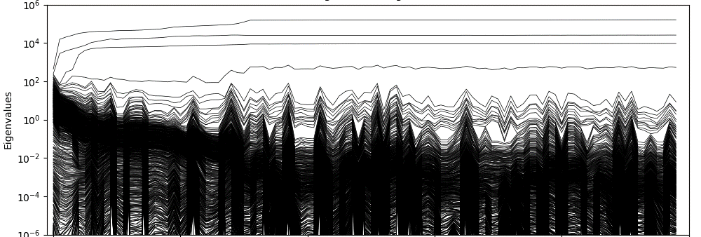
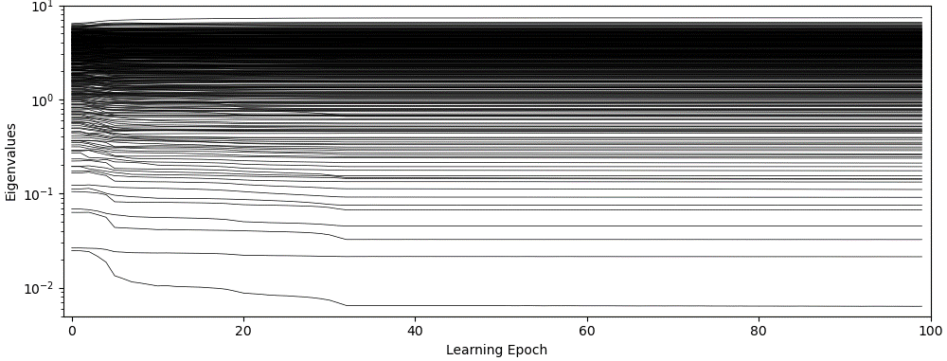
Evolution of Eigenvalues with Learning of Linear Regression
Highest eigenvalues increase
Learning Hessian
HL
Lowest
eigenvalues decrease
Physical Hessian
HP
Stern, Liu, Balasubramanian, arXiv (2023)

Slide 30
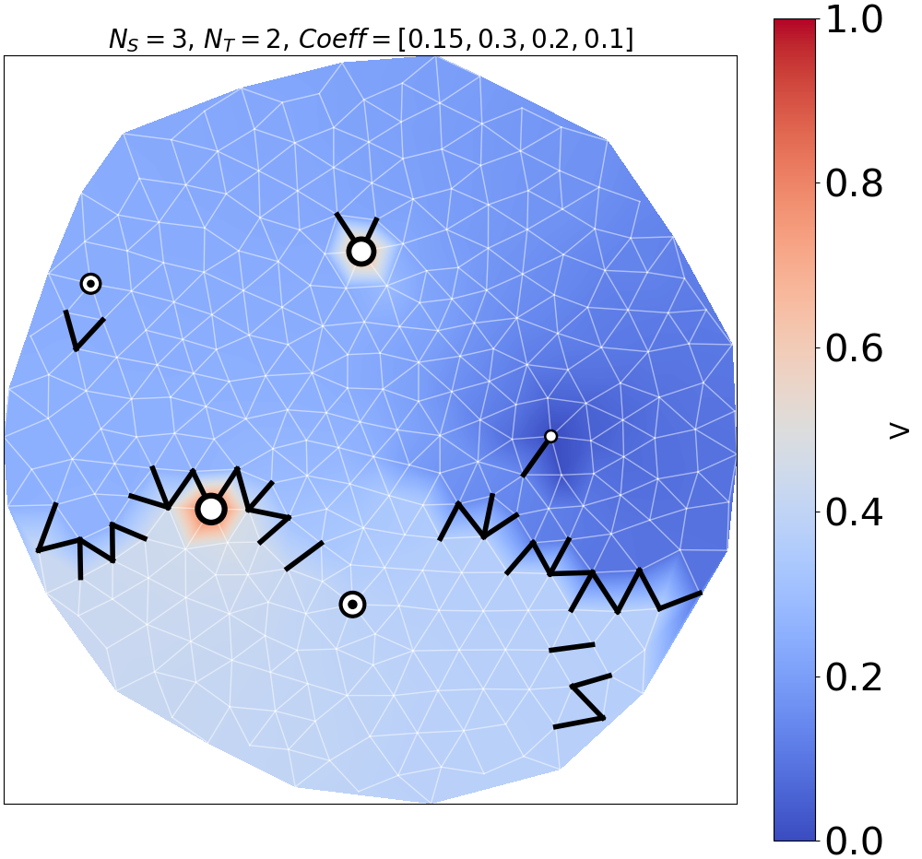
Linear Regression
S2
Low-conductance barriers direct flow to make target more sensitive to one source than the other
T1
S1
T2
Felipe Martins, Marcelo Guzman

Slide 31
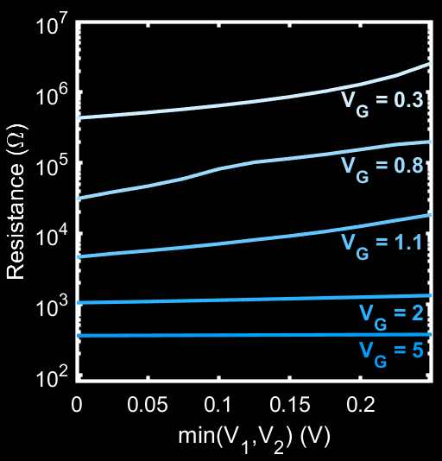
Second Generation Processor-Free Physical Learning Networks
Gen 1
Gen 2
$$V_{1}$$
$$V_{1}$$
$$R≈$$
$$V_{G}$$
$$ae^{−b(V_{G}−V_{0})}$$
$$R=nR_{0}$$
$$V_{0}≈$$
$$min(V_{1},V_{2})+ε$$
$$V_{2}$$
$$V_{2}$$
Discrete, linear
Continuous, nonlinear
Transistor based highly scalable design
Edges have slightly nonlinear IV curves
Resistance for different gate voltages

Slide 32
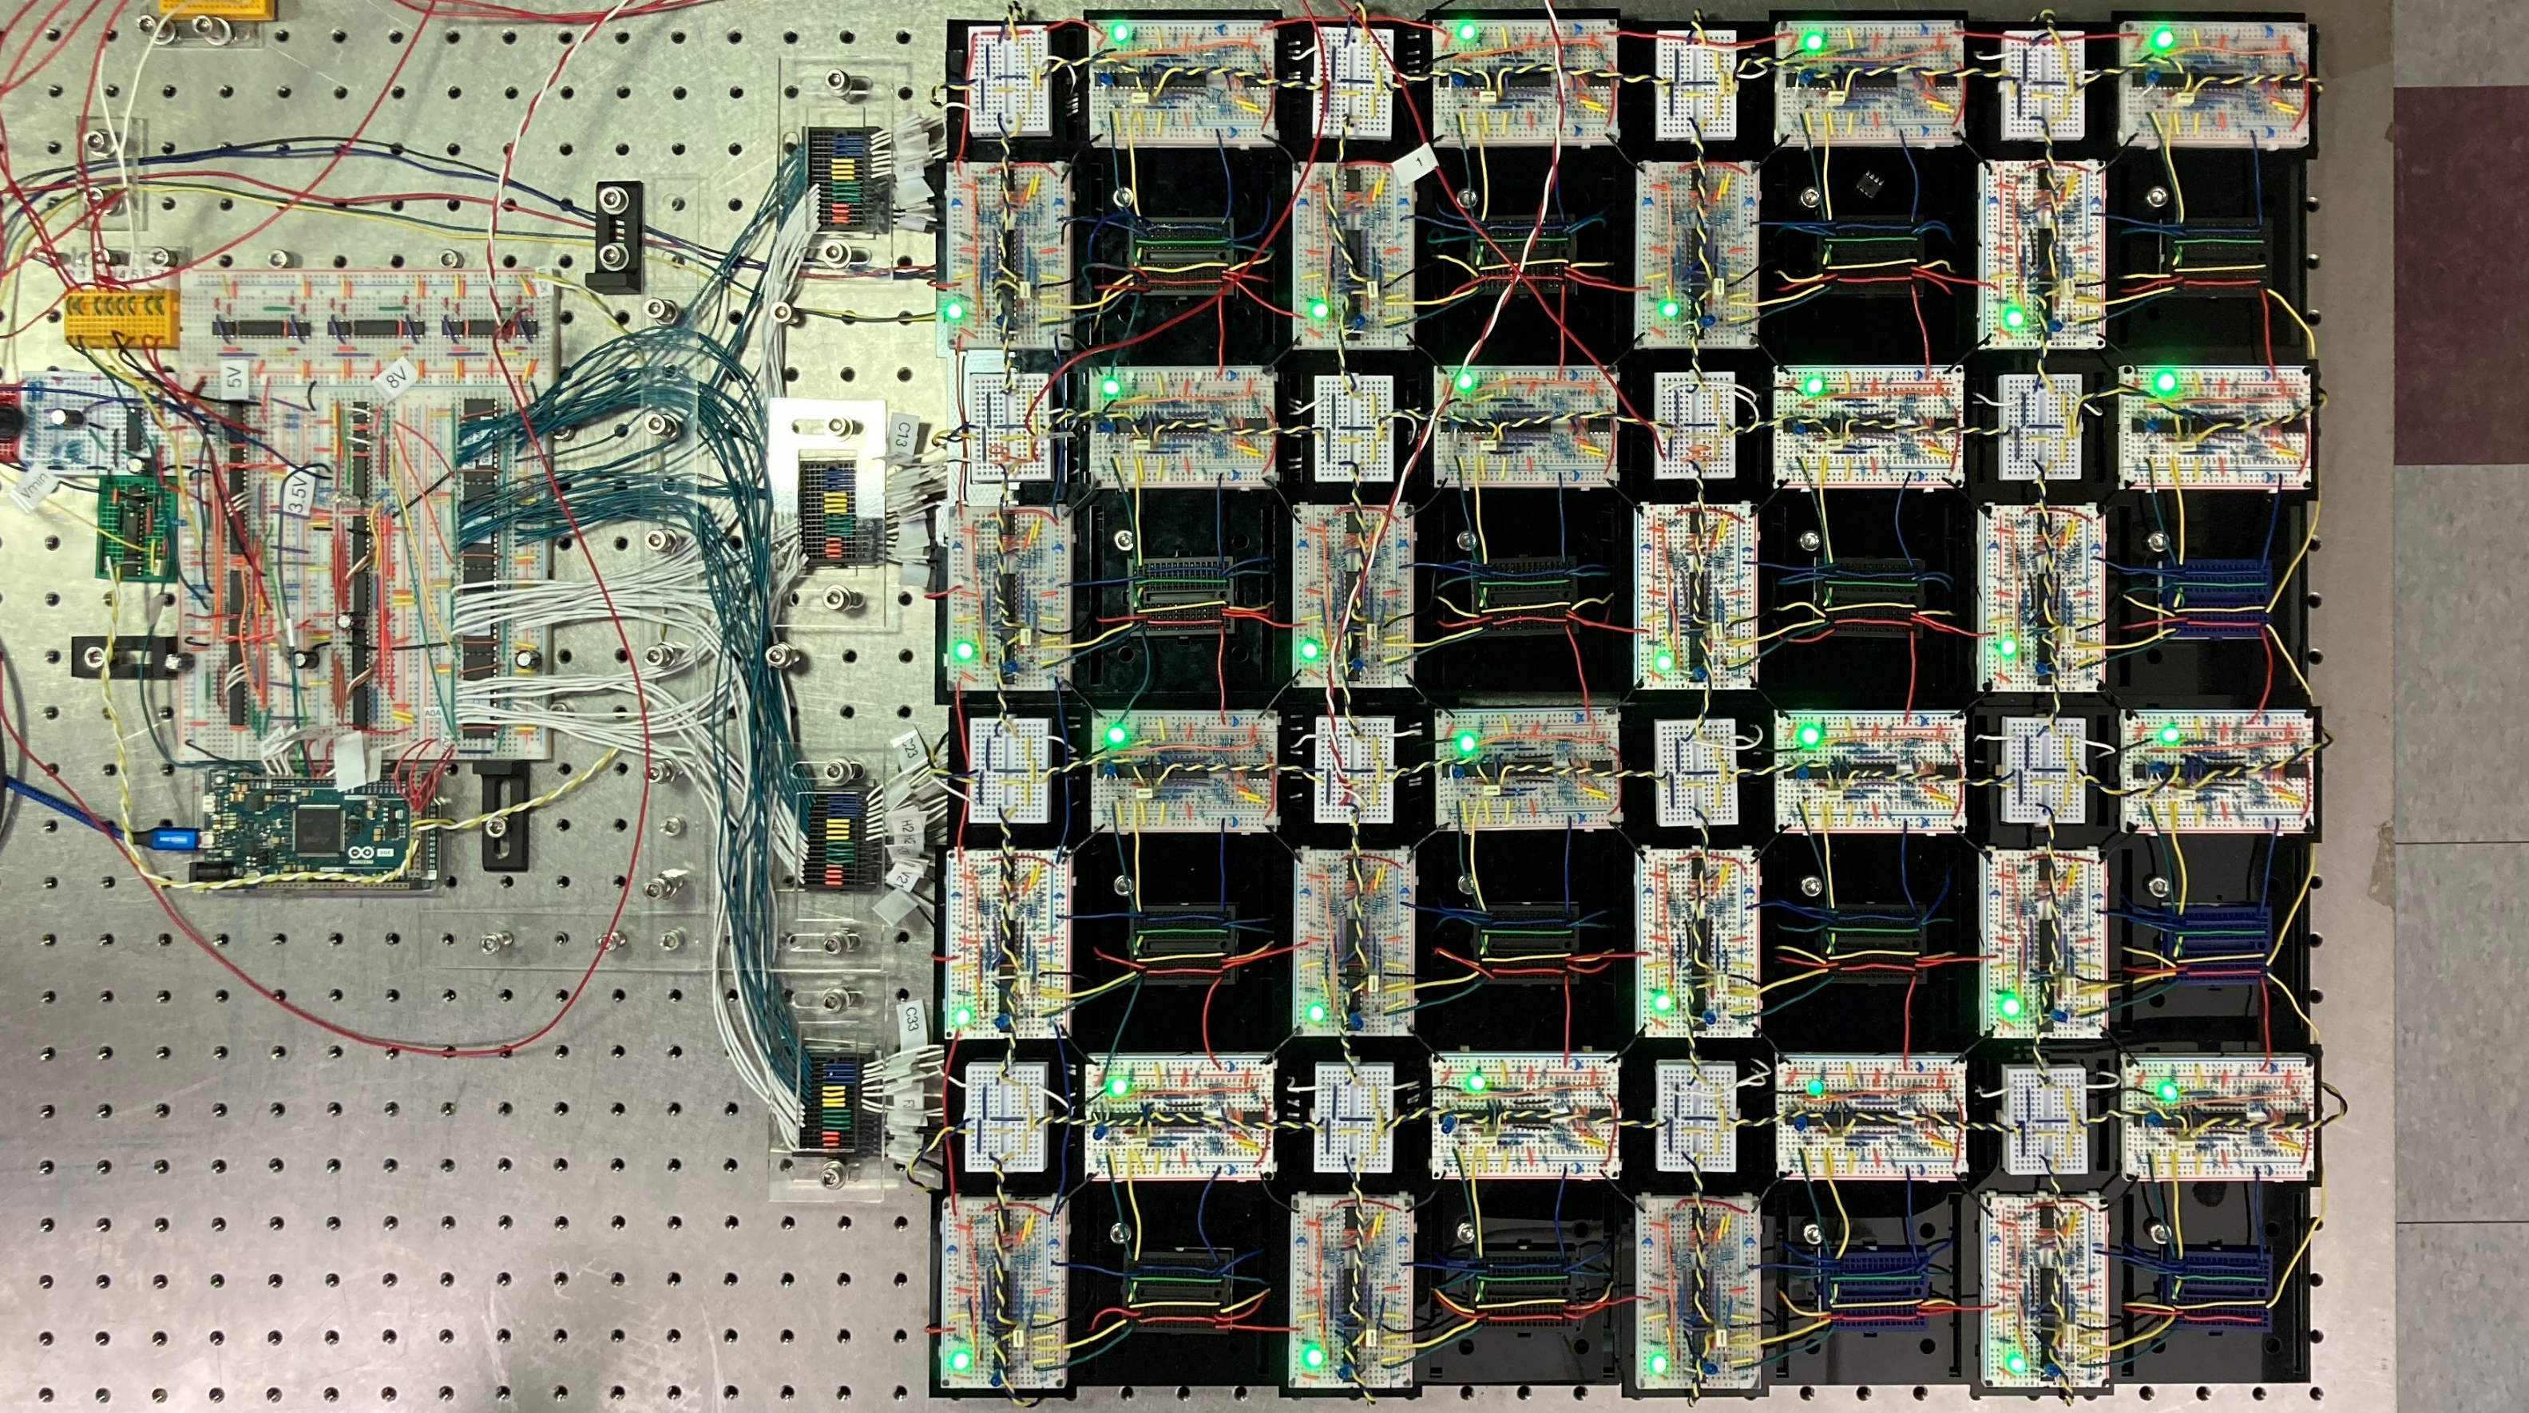
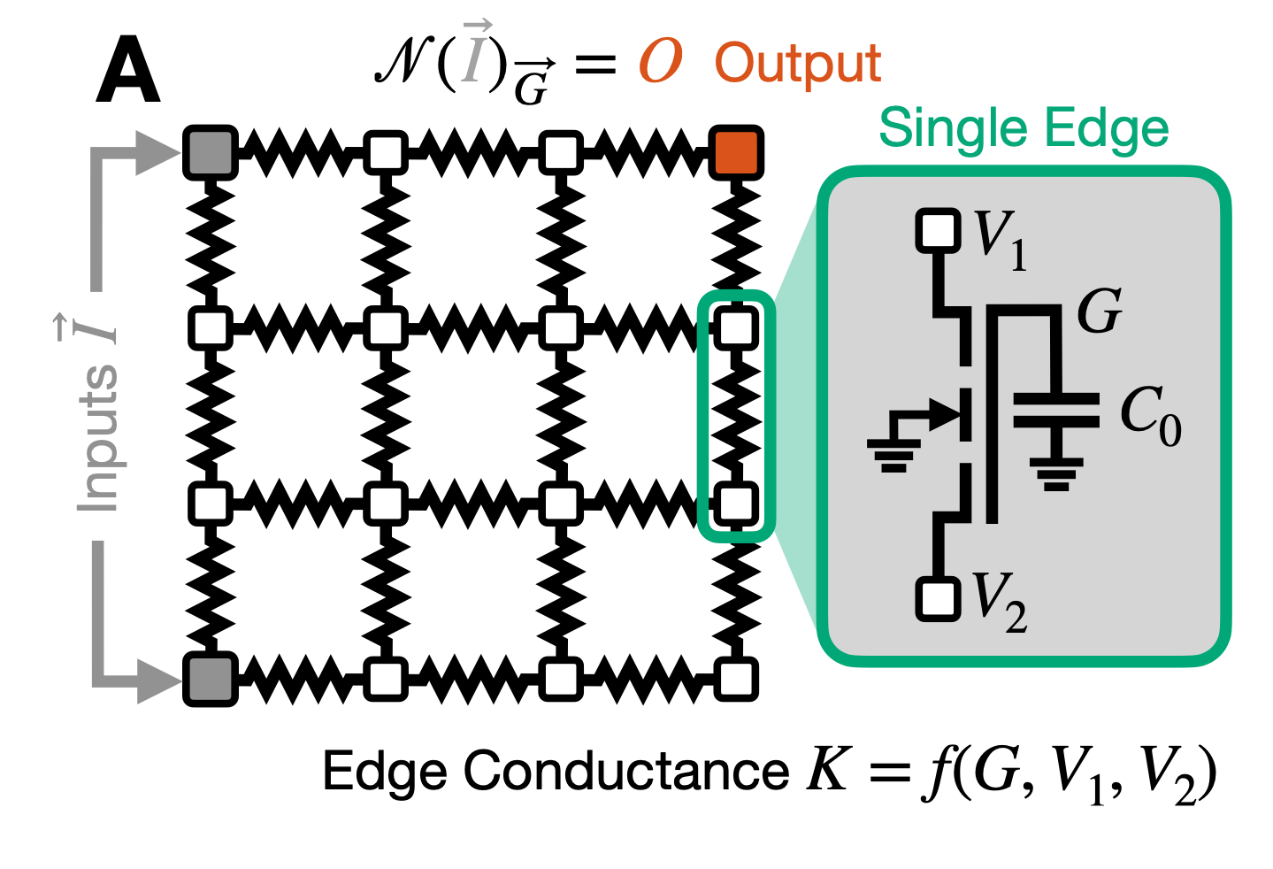
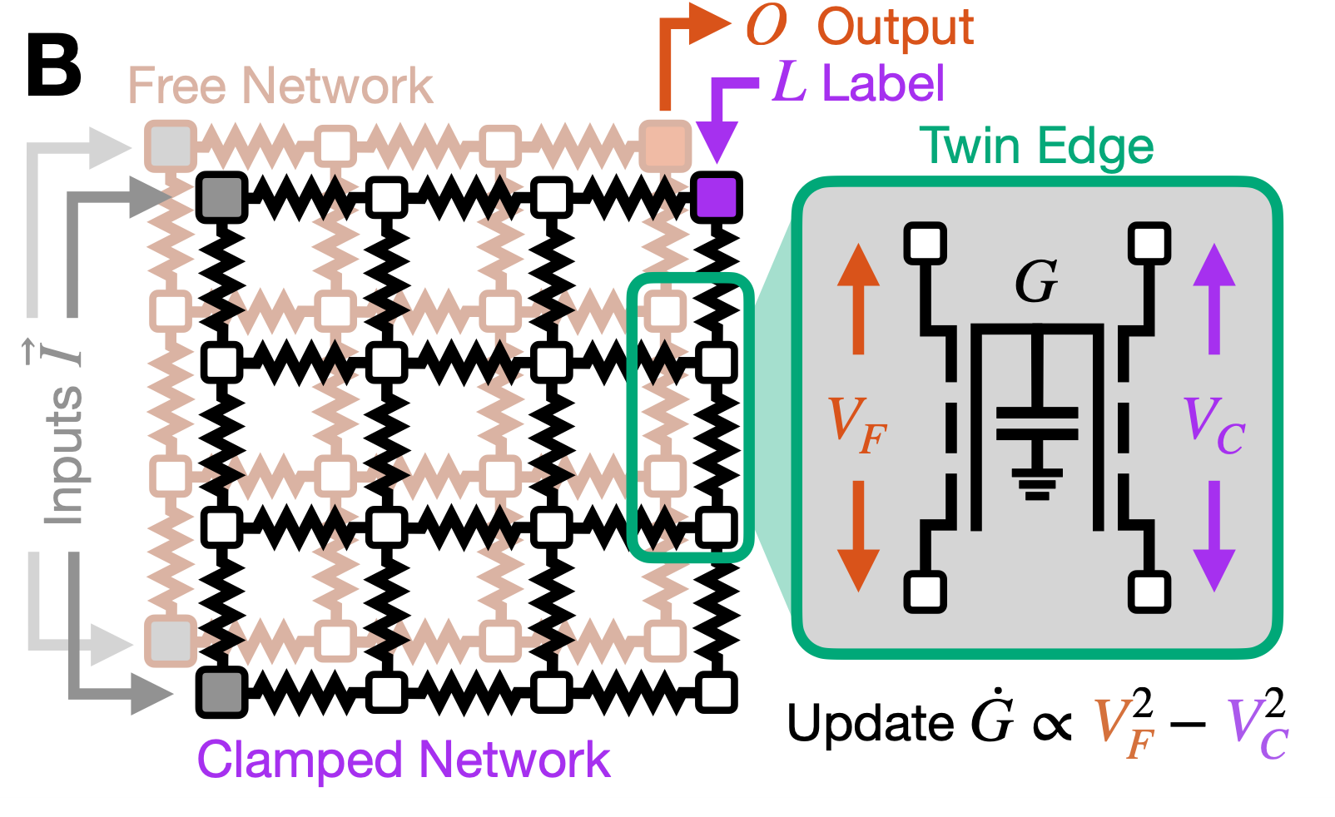
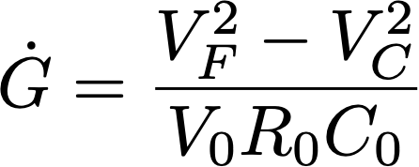
Second Generation Processor-Free Physical Learning Networks
~100μs per training step, faster than simulation (~3ms)
exact CL rule!

Slide 33
Learning Nonlinear Classification
Width of edges corresponds to conductance

Slide 34
Learning XOR

Slide 35
Learning XOR

Slide 36
To Scale Up, Need Robustness to Manufacturing Defects
Brains incredibly robust to damage
processors aren’t
our networks are
Dillavou, Stern, Liu, Durian, PR Applied (2022)

Slide 37
Scaling Up
Robustness to damage implies manufacturability
Resistance changes are calculated in parallel by every edge
Current energy/inference ~300 pJ
Comparable to ~500 pJ for 32-parameter neural network on most energy-efficient chip
Next step: printed circuit boards for networks with ~100-200 edges
Then: microfabrication of up to 10⁷ edges on a chip
Time to calculate outputs given inputs ~ nsec
Energy to calculate outputs given inputs ~10 pJ
Stay tuned!

Slide 38
Sustainability: Power Regularization
By avoiding use of processor/memory, learning circuits consume far less power than ANNs
Can lower power consumption even further with power regularization!
allostery
linear regression
Power gain increases with task complexity

Slide 39
Summary
Simultaneous optimization of learning and physical cost functions provides systematic way of solving inverse materials design problems: very general
Coupled learning provides systematic way of developing local rules to solve inverse materials design problems
Coupled learning is robust—it works in a real system!
New kind of condensed matter: processor-free physical learning networks
Playground for studying how local changes in learning DOF lead to collective phenomenon of learning
Massively scalable design suggests it might be able to replace neural networks in applications with
Low power requirements
High chance of damage

Slide 40
Thanks to
Menachem
Stern
Sam
Dillavou
Jason Rocks
Daniel Hexner
Nidhi Pashine
Irmgard Bischofberger
Carl Goodrich
NSF DMR Materials Theory
DOE Biomolecular Materials
NSF UPenn MRSEC
Simons Foundation
Eleni Katifori
Sid Nagel
Doug Durian
Marc Miskin

